Slide 1
Lab: Storing and Analyzing Data by Using Amazon Redshift
Made for Professor Lanham A. by Amrit Singh

Slide 2
AGENDA
Accessing the AWS management console
Task 1: Reviewing the IAM role to access and configure Amazon Redshift
Task 2: Creating and configuring a Redshift cluster
Task 3: Creating tables in a database
Task 4: Loading data from Amazon S3
Task 5: Querying the data
Task 6: Running queries from the AWS CLI
Task 7: Reviewing the IAM policy for Amazon Redshift access
Task 8: Confirming that users can run queries on the Redshift database

Slide 3
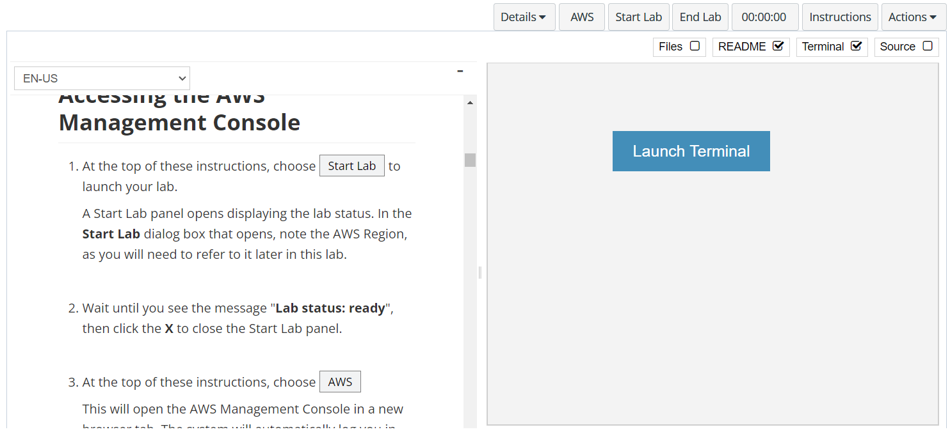
In aws labs click on start lab

Slide 4
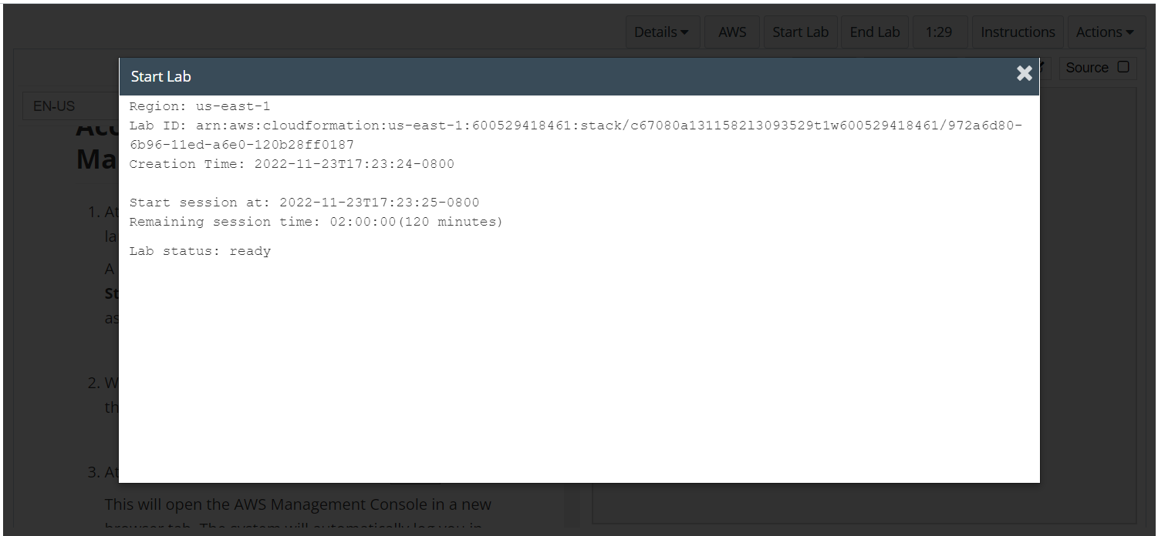
Wait to see lab ready status in the window then press x and click on aws to launch console

Slide 5
Task 1: Reviewing the IAM role to access and configure Amazon Redshift

Slide 6
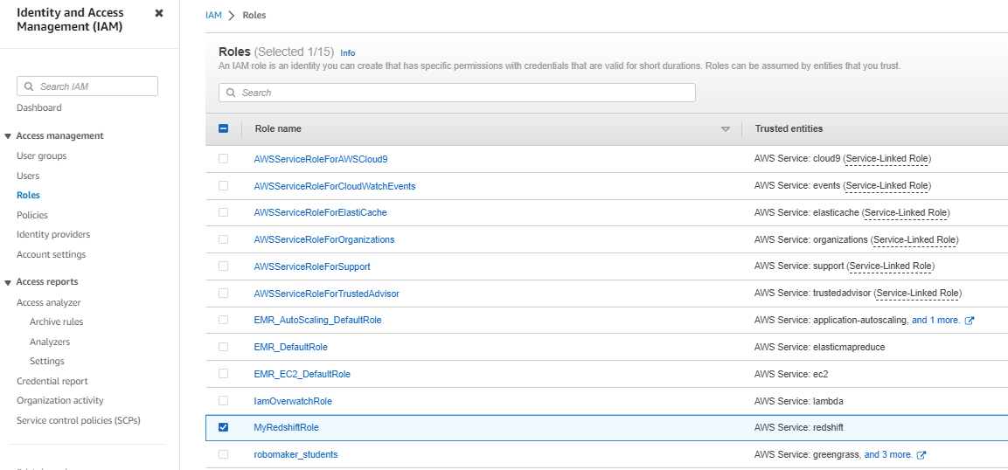
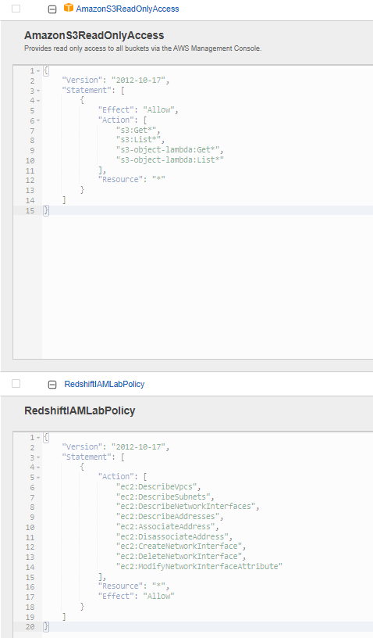
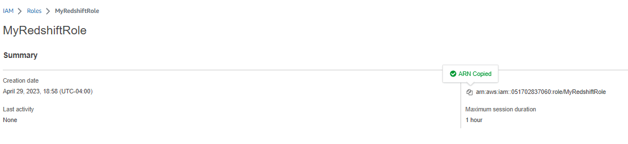
Review the iam role
Access the IAM role and get the Amazon Resource Name (ARN).
In the AWS Management Console, in the search box to the right of Services, search for and choose IAM to open the IAM console.
In the navigation pane, choose Roles.
In the roles list, search for MyRedshiftRole and then choose the link for MyRedshiftRole when it displays.
The Summary section at the top of the page displays the ARN for the role.
Copy the role's ARN to a text editor to use later.
Review the policies that are associated with the role.
Expand and review the AmazonS3ReadOnlyAccess policy.
Now expand and review the RedshiftIAMLabPolicy policy.

Slide 7
Task 2: Creating and configuring a Redshift cluster

Slide 8
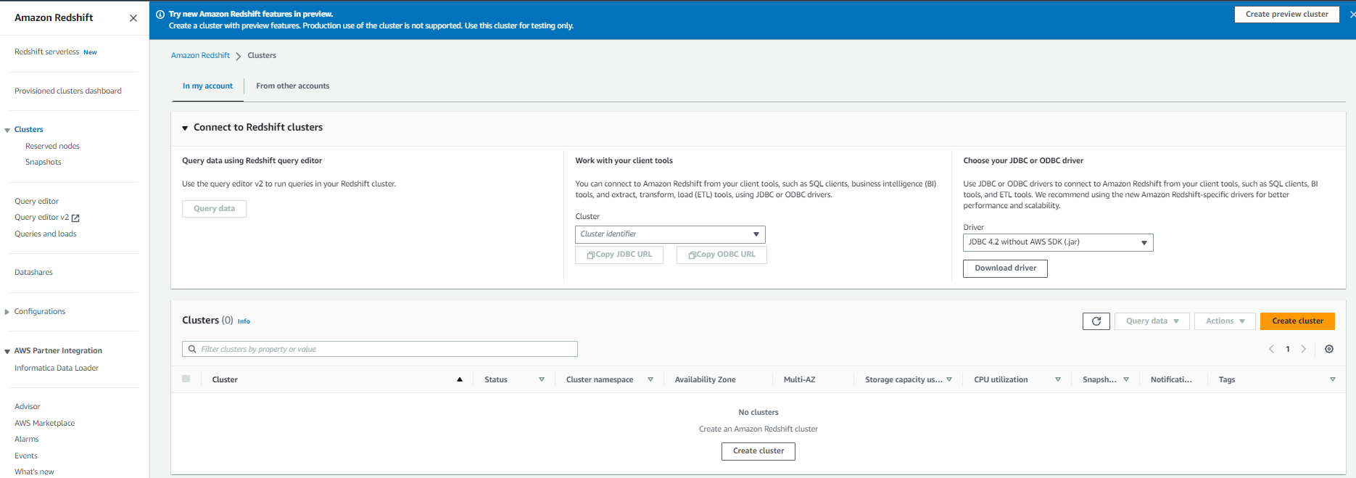
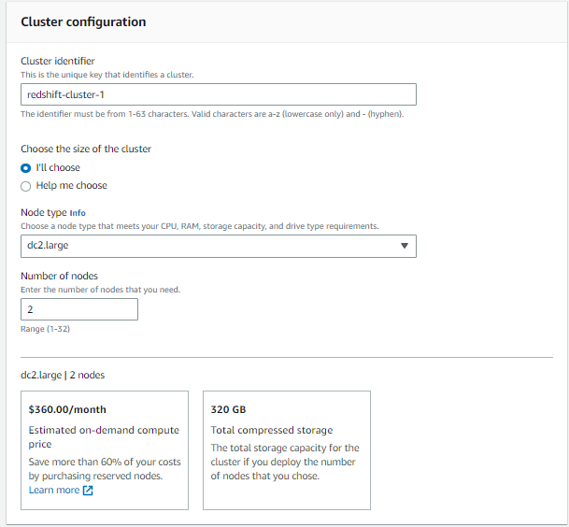
Open the redshift cluster console
Access Amazon Redshift and initiate the Redshift cluster creation process.
In the search box to the right of Services, search for and choose Amazon Redshift to open the Amazon Redshift console.
In the navigation pane, choose Clusters
Choose Create cluster
Configure the following settings for the cluster.
In the Cluster configuration section, configure the following:
Cluster identifier: Enter redshift-cluster-1
Choose Production.
Node type: Choose dc2.large.
Number of nodes: Enter 2

Slide 9
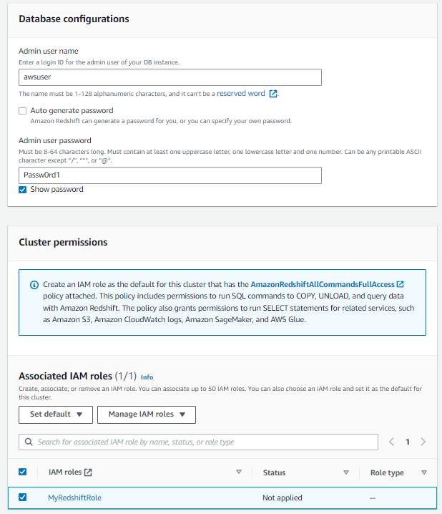
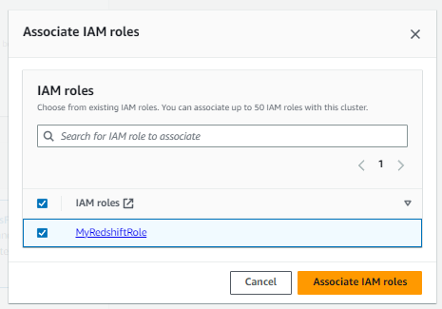
Continue setting up the cluster
In the Database configurations section, configure the following:
Admin user name: Enter awsuser
Admin user password: Enter Passw0rd1
To ensure that the password is correct, select Show password
In the Cluster permissions section, configure the following:
Choose Manage IAM roles > Associate IAM roles.
In the pop-up window, select MyRedshiftRole.
Choose Associate IAM roles.
On the cluster creation page, in the Associated IAM roles section, select MyRedshiftRole and verify that (1/1) displays to the right of the Associated IAM roles heading
At the bottom of the page, choose Create cluster.

Slide 10
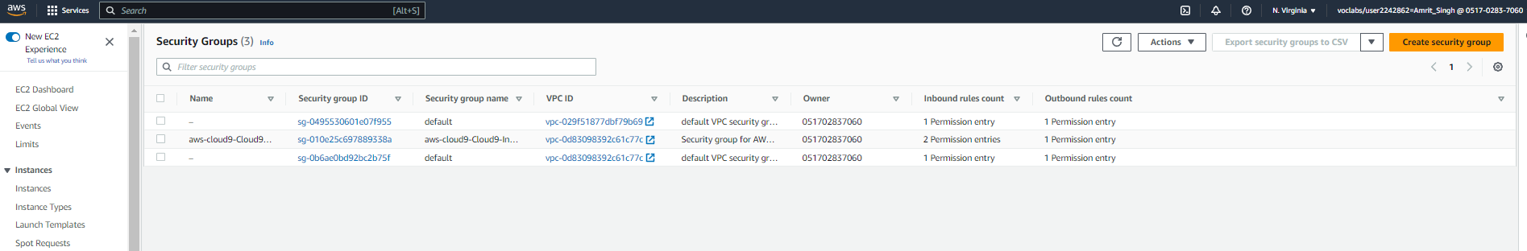
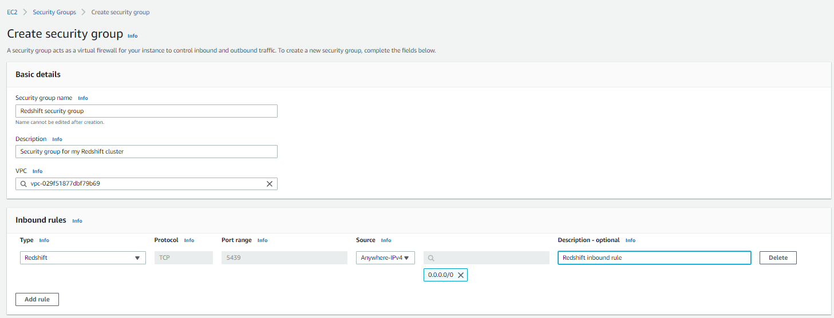
Create the security group for accessing redshift database
Create the security group and configure access to the Redshift database.
In the search box to the right of Services, search for and choose EC2 to open the Amazon EC2 console.
In the navigation pane, under Network & Security, choose Security Groups.
Choose Create security group, and configure the following:
Basic details section:
Security group name: Enter Redshift security group
Description: Enter Security group for my Redshift cluster
Inbound rules section:
Choose Add rule.
Type: Choose Redshift. Note that the protocol and port range automatically update to TCP and 5439.
Source: Choose Anywhere-IPv4. Note that 0.0.0.0/0 is automatically added.
Description: Enter Redshift inbound rule
At the bottom of the page, choose Create security group.

Slide 11
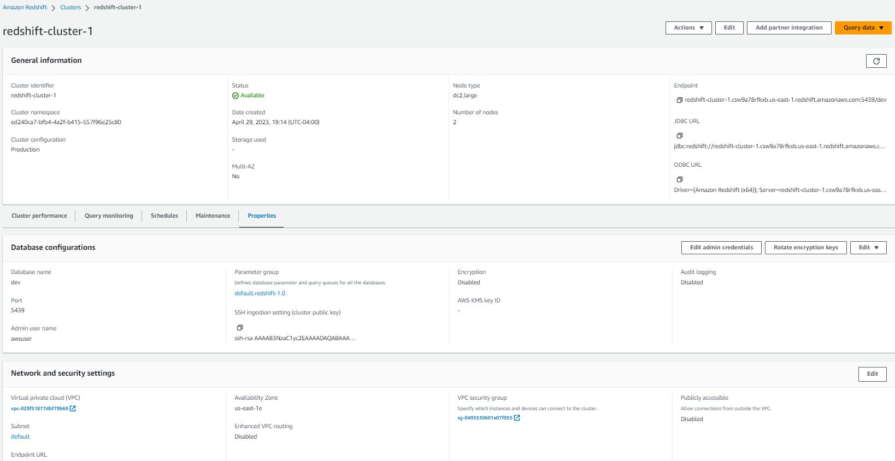
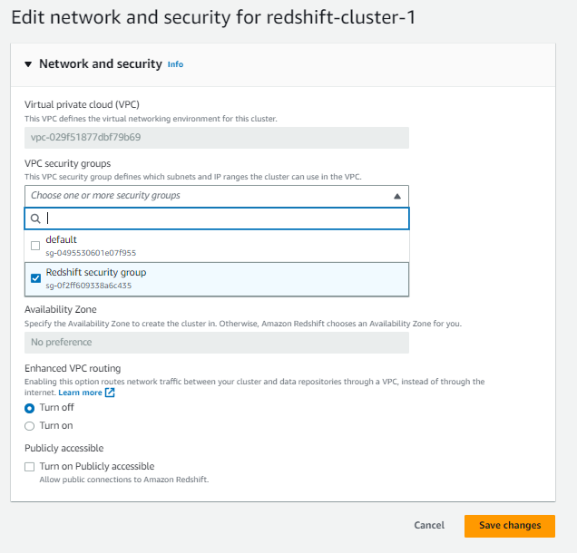
Create the security group for accessing redshift database
Configure your Redshift cluster.
Navigate to the Amazon Redshift console.
In the navigation pane, choose Clusters.
When the Status is Available for the cluster that you created, choose the link for the redshift-cluster-1 cluster.
Choose the Properties tab.
In the Network and security settings section, choose Edit.
For VPC security groups, select Redshift security group AND clear default.
Choose Save changes.

Slide 12
Task 3: Creating tables in a database

Slide 13
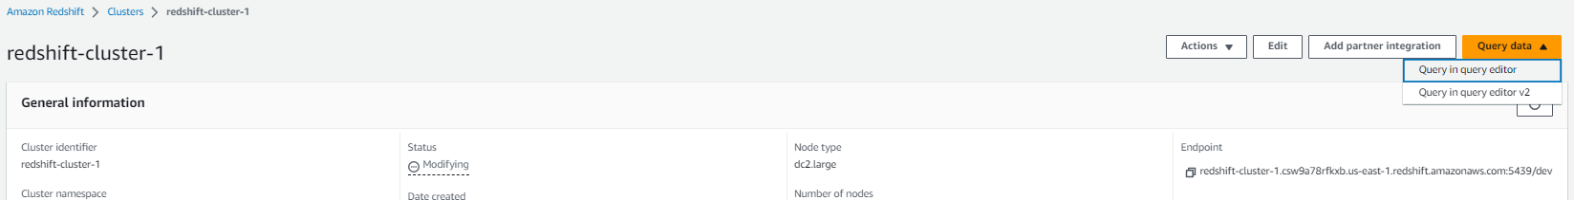
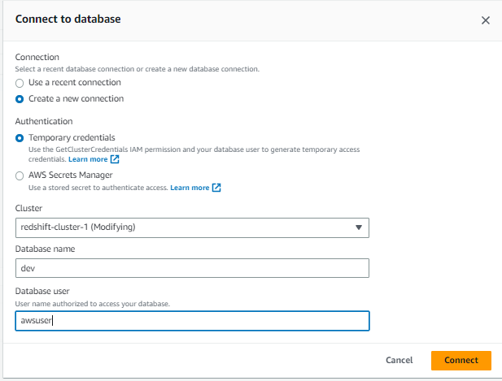
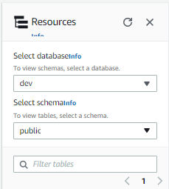
Connect to the redshift cluster and configure it to run the database
Connect to the Redshift cluster and access the query editor.
In the navigation pane, choose Clusters.
Select the redshift-cluster-1 cluster, and choose Query data > Query in query editor.
Choose Connect to database and configure the following:
Connection: Choose Create a new connection.
Authentication: Choose Temporary credentials.
Database name: Enter dev
Database user: Enter awsuser
In the Resources pane of the query editor, for Select schema, choose public.

Slide 14
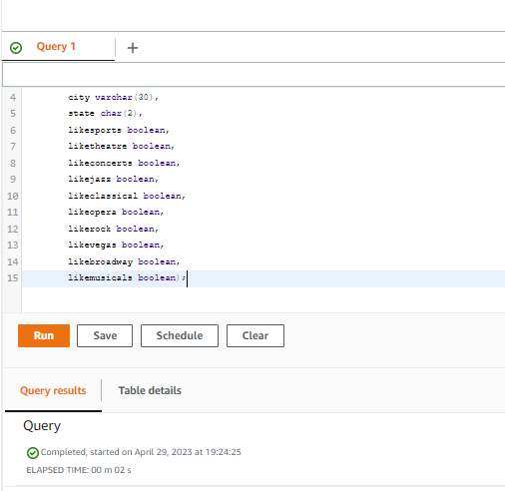
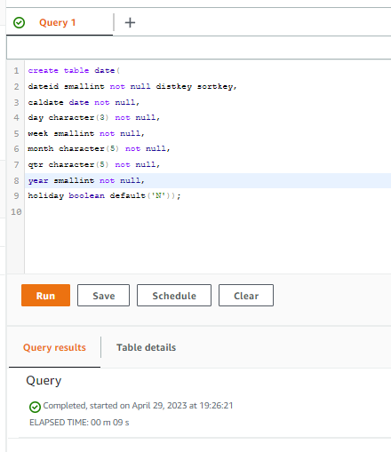
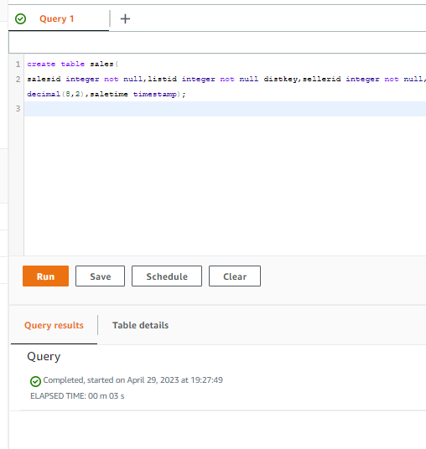
Create the required tables in redshift
To create the users table, copy and paste the following text into a query tab, and choose Run:
To create the date table, copy and paste the following text into a new query tab, and choose Run:
To create the sales table, copy and paste the following text into a new query tab, and choose Run:
create table users(
userid integer not null distkey sortkey, username char(8), city varchar(30), state char(2), likesports boolean, liketheatre boolean, likeconcerts boolean, likejazz boolean, likeclassical boolean, likeopera boolean, likerock boolean, likevegas boolean, likebroadway boolean, likemusicals boolean);
create table date(
dateid smallint not null distkey sortkey,caldate date not null,day character(3) not null,week smallint not null,month character(5) not null,qtr character(5) not null,year smallint not null,holiday boolean default('N'));
create table sales(
salesid integer not null,listid integer not null distkey,sellerid integer not null,buyerid integer not null,eventid integer not null,dateid smallint not null sortkey,qtysold smallint not null,pricepaid decimal(8,2),commission decimal(8,2),saletime timestamp);

Slide 15
Task 4: Loading data from Amazon S3

Slide 16
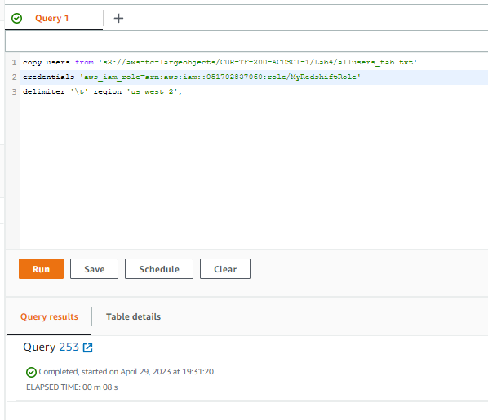
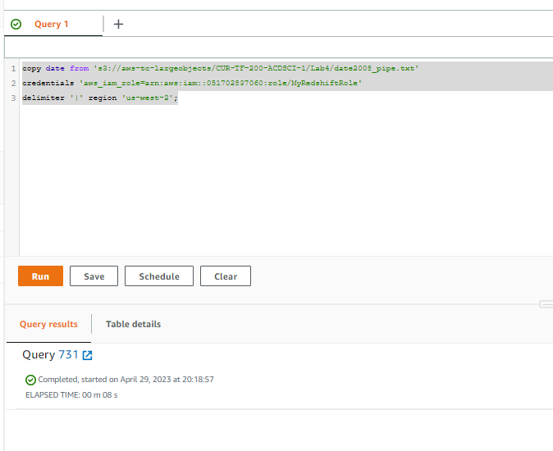
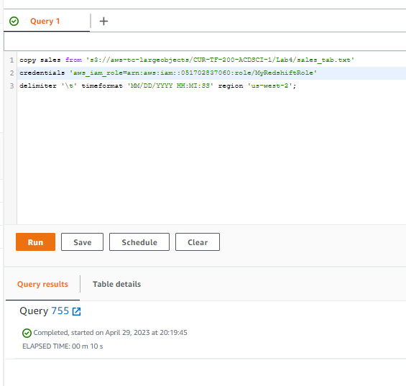
Open the storage gateway page
To load data to the users table, run the following query. Replace <REDSHIFT-ROLE-ARN> with the ARN that you copied for the MyRedshiftRole IAM role earlier in the lab:
To load data to the date table, run the following query. Replace <REDSHIFT-ROLE-ARN> with the ARN that you copied for the MyRedshiftRole IAM role earlier in the lab:
To load data to the sales table, run the following query. Replace <REDSHIFT-ROLE-ARN> with the ARN that you copied for the MyRedshiftRole IAM role earlier in the lab:
copy users from 's3://aws-tc-largeobjects/CUR-TF-200-ACDSCI-1/Lab4/allusers_tab.txt'
credentials 'aws_iam_role=<REDSHIFT-ROLE-ARN>'delimiter '\t' region 'us-west-2';
copy date from 's3://aws-tc-largeobjects/CUR-TF-200-ACDSCI-1/Lab4/date2008_pipe.txt'
credentials 'aws_iam_role=<REDSHIFT-ROLE-ARN>'delimiter '|' region 'us-west-2';
copy sales from 's3://aws-tc-largeobjects/CUR-TF-200-ACDSCI-1/Lab4/sales_tab.txt'
credentials 'aws_iam_role=<REDSHIFT-ROLE-ARN>'delimiter '\t' timeformat 'MM/DD/YYYY HH:MI:SS' region 'us-west-2';

Slide 17
Task 5: Querying the data

Slide 18
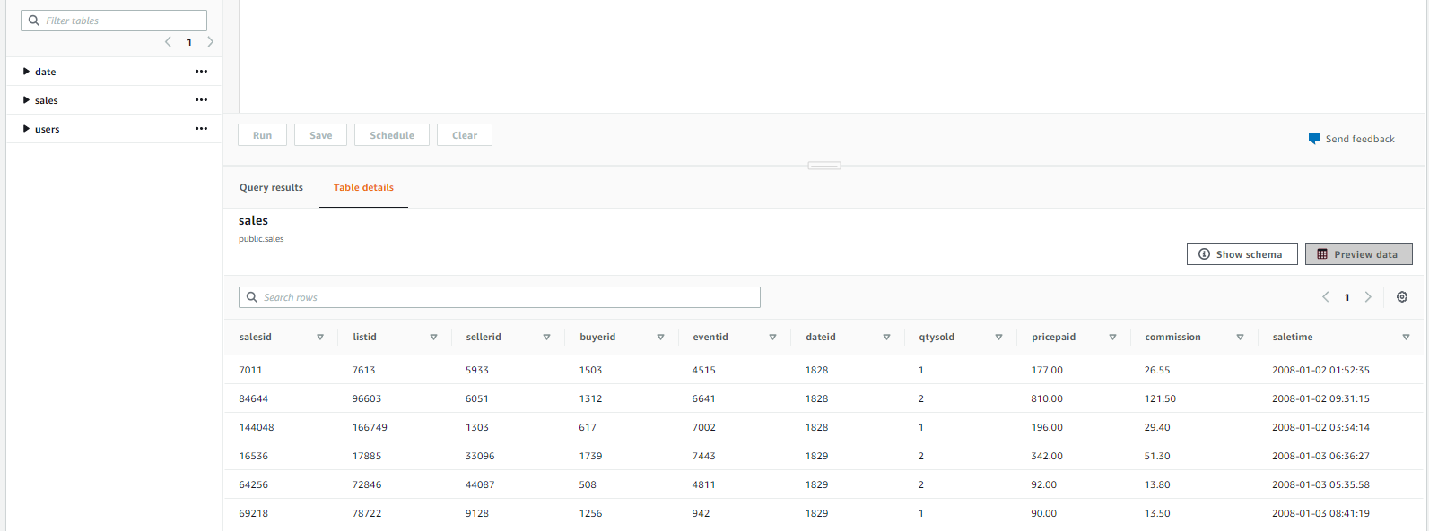
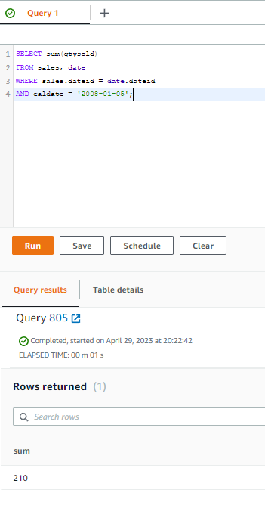
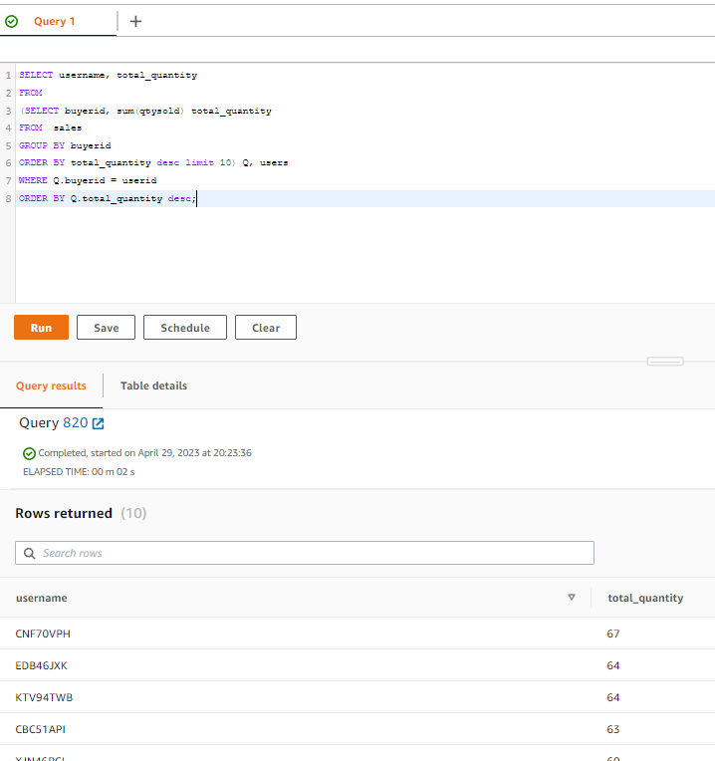
Return to the lambda console and create a new function
Preview the sales table.
In the Resources pane, to the right of sales, choose the ellipsis (three dot) icon, and choose Preview data.
Run the following query in the query editor:
Run the following query in the query editor:
SELECT sum(qtysold)
FROM sales, dateWHERE sales.dateid = date.dateidAND caldate = '2008-01-05';
SELECT username, total_quantity
FROM(SELECT buyerid, sum(qtysold) total_quantityFROM salesGROUP BY buyeridORDER BY total_quantity desc limit 10) Q, usersWHERE Q.buyerid = useridORDER BY Q.total_quantity desc;

Slide 19
Task 6: Running queries from the AWS CLI

Slide 20
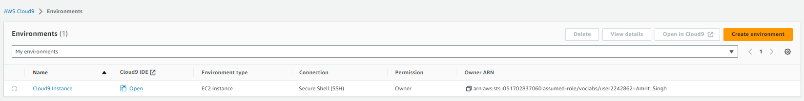
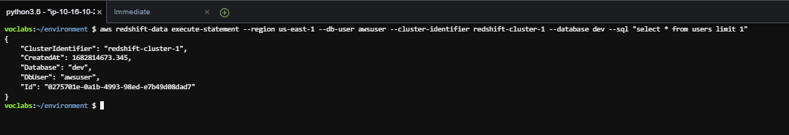
Go to cloud9 and perform the following queries
Navigate to the AWS Cloud9 integrated development environment (IDE).
In the AWS Management Console, in the search box next to Services, search for and choose Cloud9 to open the AWS Cloud9 console.
For the environment named Cloud9 Instance, choose Open IDE.
Query records from the dev database.
Run the following command in the AWS Cloud9 terminal.
Notice the information that is provided in the output:
ClusterIdentifier: Identifies the Redshift cluster that you ran the query on
CreatedAt: Gives the time that the query was created
Database: Identifies the database that you ran the query on
DbUser: Identifies the user who ran the query
Id: Gives the ID for the query
Copy the Id value to a text editor to use in the next command
aws redshift-data execute-statement --region us-east-1 --db-user awsuser --cluster-identifier redshift-cluster-1 --database dev --sql "select * from users limit 1"

Slide 21
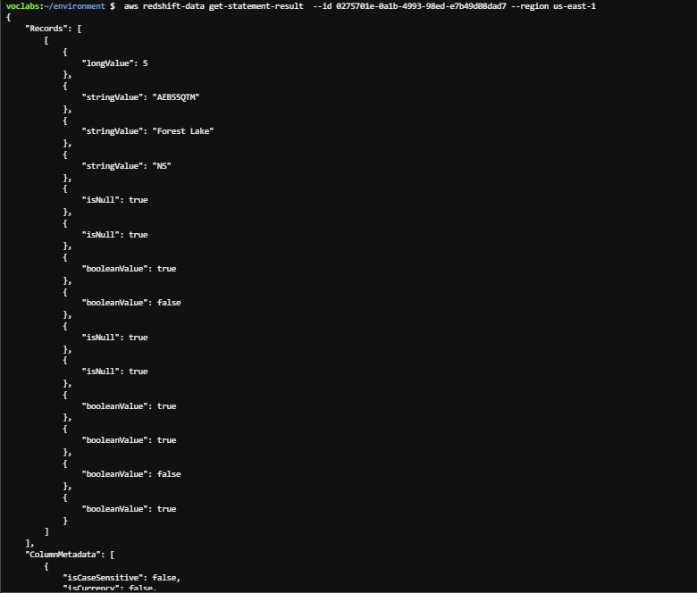
Retrieve the query results and run the following
To retrieve the results of the query, run the following get-statement-result command. Replace <QUERY-ID> with the query ID that you copied.
aws redshift-data get-statement-result --id <QUERY-ID> --region us-east-1

Slide 22
Task 7: Reviewing the IAM policy for Amazon Redshift access

Slide 23
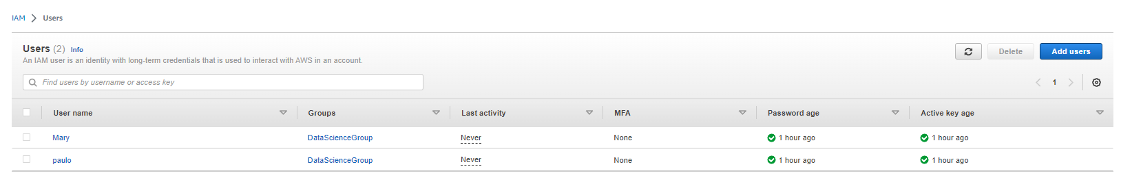
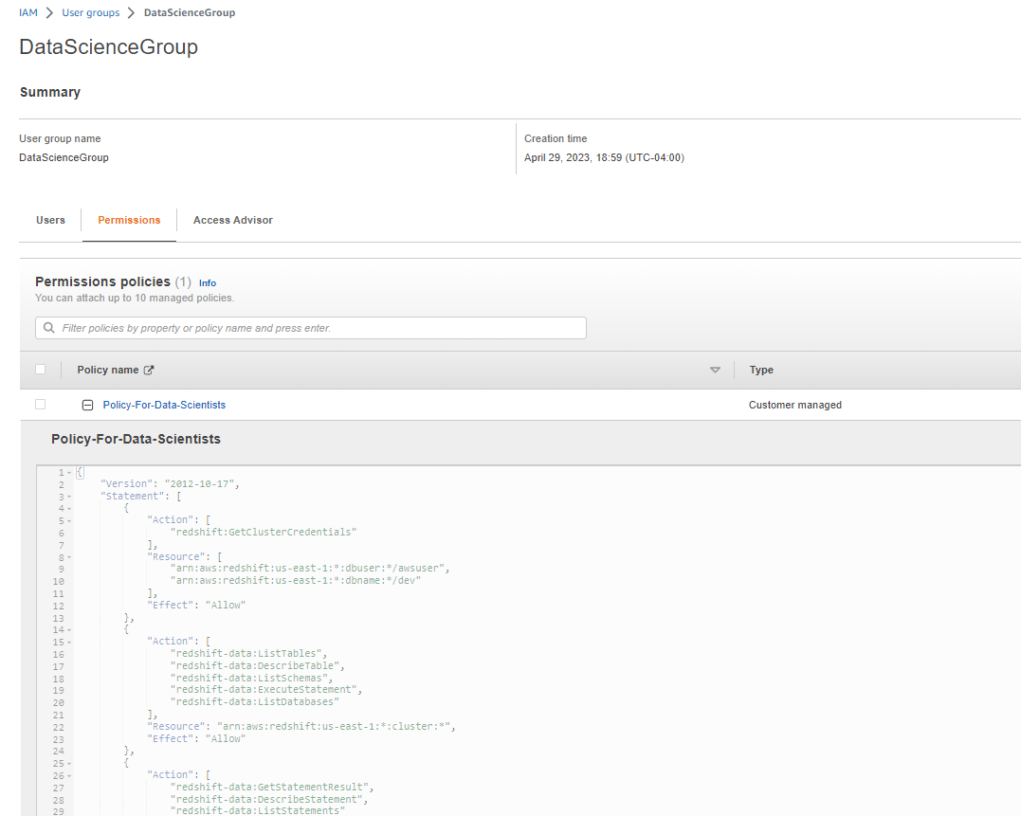
Analyze the iam policy created for you
Review the Policy-For-Data-Scientists IAM policy, which was created for you.
Navigate to the IAM console.
In the navigation pane, choose Users.
Notice the Mary user that is listed. This user is part of the DataScienceGroup IAM group.
Choose the link for the DataScienceGroup IAM group.
Choose the Permissions tab.
The policy that is attached to this group is displayed.
Choose the link for the Policy-For-Data-Scientists policy.

Slide 24
Task 8: Confirming that users can run queries on the Redshift database

Slide 25
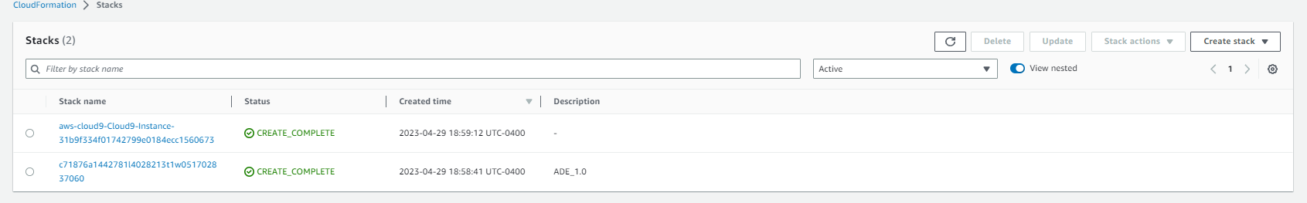
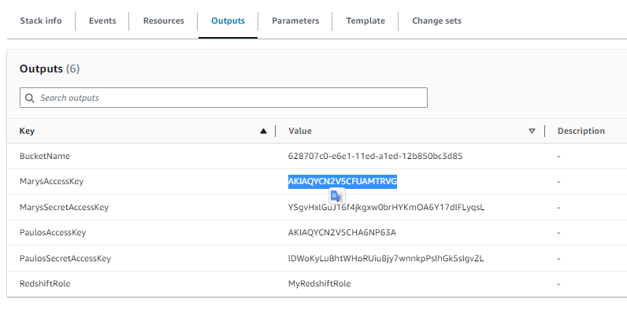

COPY MARY’S ACCESS AND SECRET KEYS AND PASS TO ide
Retrieve the credentials for the Mary IAM user, and store these as bash variables.
In the search box next to Services, search for and choose CloudFormation.
In the navigation pane, choose Stacks.
Choose the link for the stack that created the lab environment. The stack name includes a random string of letters and numbers, and the stack should have the oldest creation time.
On the stack details page, choose the Outputs tab.
Copy the value of MarysAccessKey to your clipboard.
Return to the AWS Cloud9 terminal.
To create a variable for the access key, run the following command. Replace <ACCESS-KEY> with the value from your clipboard.
AK=<ACCESS-KEY>
Return to the CloudFormation console, and copy the value of MarysSecretAccessKey to your clipboard.
Return to the AWS Cloud9 terminal.
To create a variable for the secret access key, run the following command. Replace <SECRET-ACCESS-KEY> with the value from your clipboard.
SAK=<SECRET-ACCESS-KEY>

Slide 26
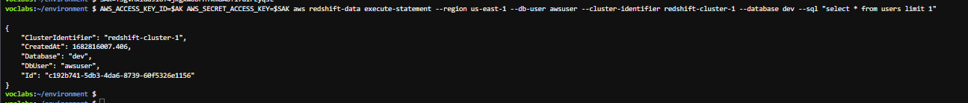
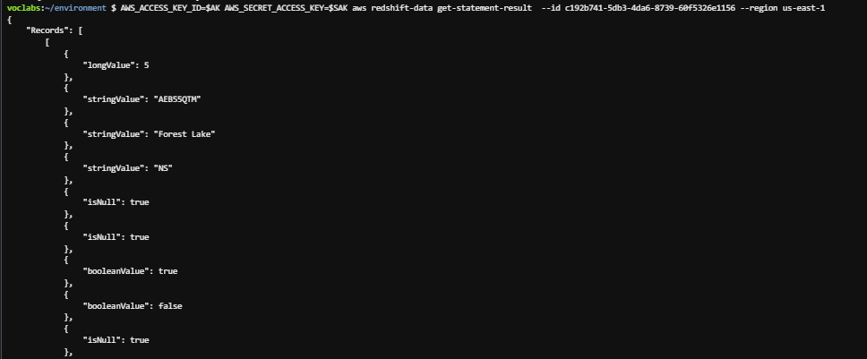
Analyze the iam policy created for you
Use the execute-statement command in the Redshift Data API to query the database.
Run the following command in the AWS Cloud9 terminal.
To retrieve the query results, copy the following command, replace the placeholder with the Id in the response above, then run the command in the terminal:
AWS_ACCESS_KEY_ID=$AK AWS_SECRET_ACCESS_KEY=$SAK aws redshift-data execute-statement --region us-east-1 --db-user awsuser --cluster-identifier redshift-cluster-1 --database dev --sql "select * from users limit 1"
AWS_ACCESS_KEY_ID=$AK AWS_SECRET_ACCESS_KEY=$SAK aws redshift-data get-statement-result --id <QUERY-ID> --region us-east-1

Slide 27
THANK YOU
Amrit Singh

